Slide 1


MAZE Global Superstore
The Global Superstore dataset is data from a global retail chain that sells office supplies, Furniture and Technology Stuff.
Our target is to create a dashboard based on this imaginary company dataset.

Slide 2
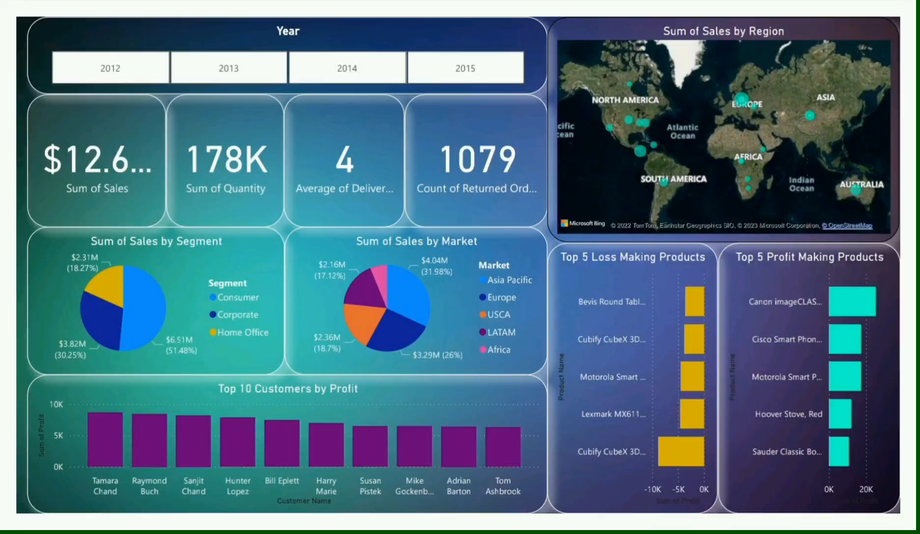
Report Comparison of 4 years i.e.2012,2013,2014 and 2015 as per imaginary dataset.

